Slide 1



Comprehensive Analysis of Netflix TV Shows and Movies Dataset
This presentation delves into the Netflix dataset, examining trends, insights, and valuable information about the platform's diverse content library. The analysis explores various aspects of the dataset, from content popularity and genre trends to demographic preferences and regional variations.
by Anupam Singh

Slide 2


Project Overview
This project aims to conduct a comprehensive analysis of the Netflix dataset. We will explore the data to uncover key insights and patterns, providing valuable information for stakeholders across different departments.
Understanding Content
Gain insights into the types of content that resonate with viewers and identify opportunities for future content acquisition.
Optimizing Marketing Strategies
Tailor marketing campaigns based on audience demographics, content popularity, and regional trends.
Informed Decision-Making
Support strategic decisions regarding content investments, market expansion, and overall platform growth.

Slide 3
Stakeholders
This project is designed to serve the needs of various stakeholders within Netflix, including those involved in content acquisition, marketing, and executive leadership.
Content Acquisition Team
Marketing Team
Executive Leadership
Gain insights into content trends and preferences to inform future acquisition strategies.
Tailor marketing strategies based on content popularity, audience demographics, and regional trends.
Provide data-driven insights to support strategic decision-making regarding content investments, market expansion, and overall platform growth.
Genre popularity
Regional demand
Promotional campaigns
Targeted advertising
Content budget allocation
Audience demographics
Content recommendations
Market research
Long-term strategy

Slide 4

Project Requirements
This project involves several key steps to ensure a comprehensive and insightful analysis of the Netflix dataset.
1
Data Cleaning
Ensure data accuracy and completeness by handling missing values, inconsistencies, and irrelevant information.
2
Data Analysis
Perform exploratory data analysis to uncover patterns, trends, and correlations within the dataset.
3
Insight Generation
Answer specific business questions related to content popularity, audience demographics, and regional trends.
4
Reporting and Visualization
Present findings clearly and effectively through visualizations and reports, making the information accessible to stakeholders.

Slide 5

Data Cleaning Process
The data cleaning process is crucial to ensure the accuracy and reliability of the analysis. This involves identifying and addressing various data quality issues.
Missing Value Handling
1
Identify and address missing values using appropriate techniques such as imputation or deletion, depending on the nature of the data.
2
Inconsistent Data Treatment
Standardize data formats, units of measurement, and ensure consistency across different data sources.
Irrelevant Information Removal
3
Remove irrelevant columns or rows from the dataset to focus on the most relevant information for the analysis.
4
Data Validation
Verify data accuracy and consistency through validation checks and quality assurance measures.

Slide 6
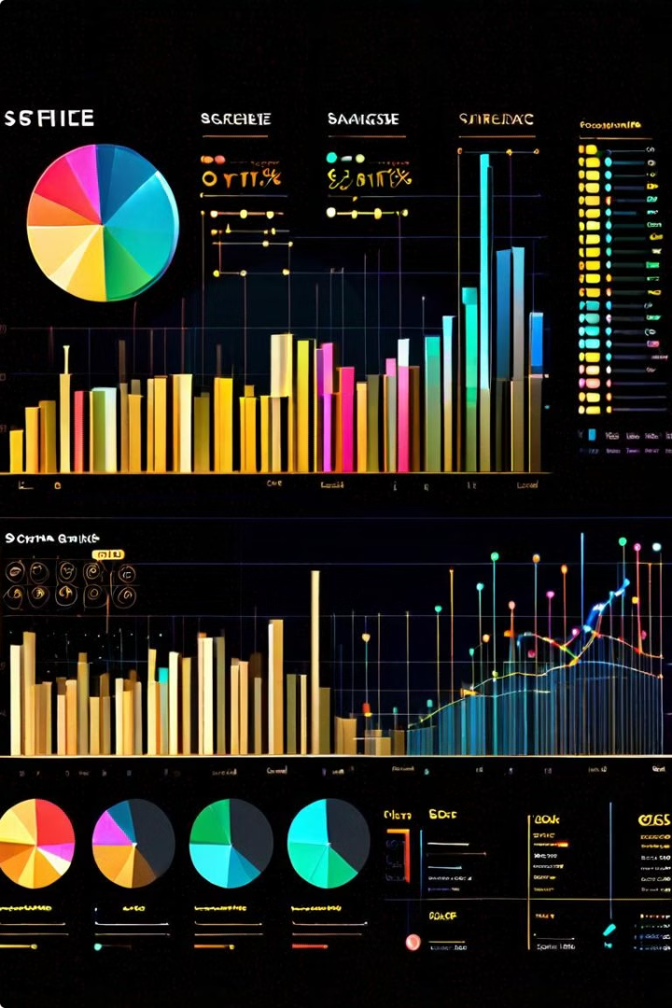
Data Analysis
The data analysis phase involves exploring the cleaned dataset to uncover patterns, trends, and insights.
Exploratory Data Analysis
Identify key variables, relationships, and trends within the data.
Statistical Analysis
Apply statistical methods to quantify patterns and relationships within the data.
Data Visualization
Create visual representations of the data to enhance understanding and communication of findings.
Correlation Analysis
Investigate relationships between different variables to identify potential dependencies and influences.

Slide 7
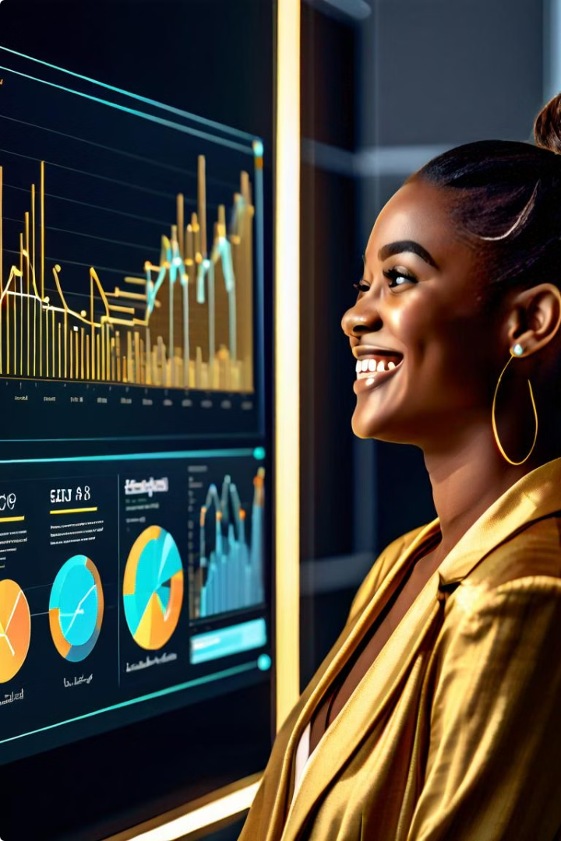
Insight Generation
The analysis generates actionable insights that can be used by Netflix stakeholders to make informed decisions.
1
Content Trends and Preferences
Identify popular genres, content types, and regional variations in audience preferences.
2
Audience Demographics
Understand the demographics of Netflix users, including age, gender, location, and interests.
3
Content Performance
Analyze the performance of different content items based on viewership data and ratings.
4
Regional Variations
Identify regional trends in content consumption and preferences, providing insights into market segmentation.

Slide 8





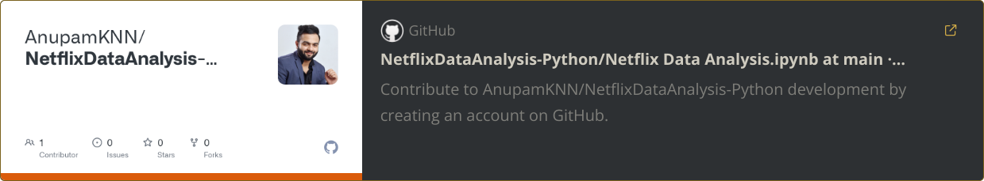
Jupyter Notebook
The analysis is conducted using a Jupyter Notebook, a powerful tool for interactive data analysis, visualization, and reporting.
Python Libraries
Data Exploration
Insight Generation
Report Generation
Leveraging Python libraries such as pandas, numpy, and matplotlib for data manipulation, analysis, and visualization.
Conducting exploratory data analysis to uncover patterns and trends within the dataset.
Generating actionable insights based on the analysis to inform decision-making.
Creating clear and concise reports to communicate the findings effectively to stakeholders.

Slide 9
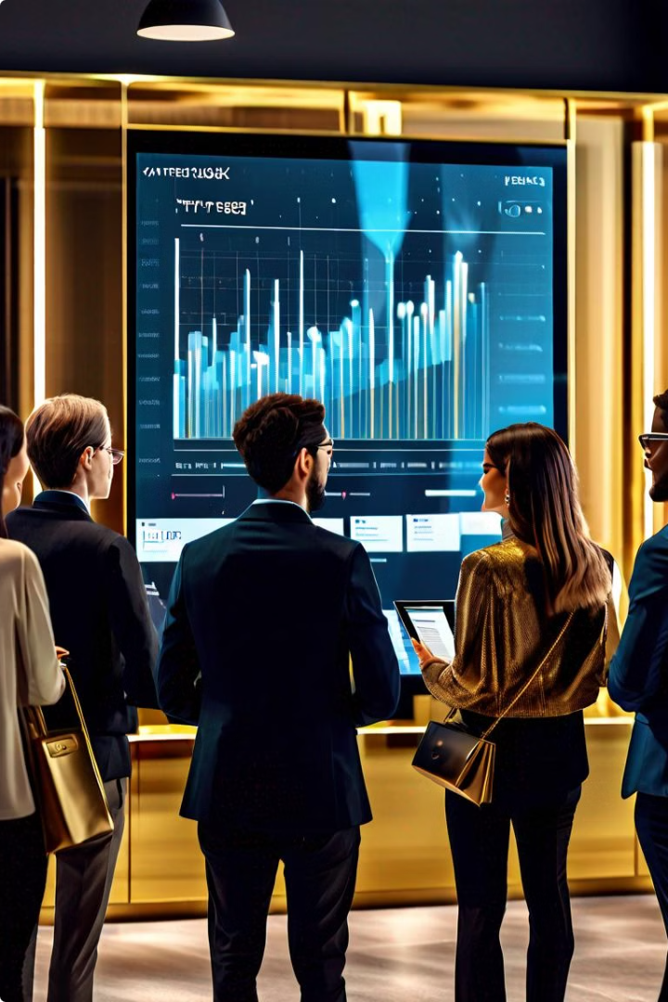



Thank You
We appreciate your time and attention. We hope this analysis has provided valuable insights into the Netflix dataset.
Q&A Session
We are happy to answer any questions you may have about the project, methodology, or findings.
Discussion
We welcome your feedback and insights on how this information can be further leveraged to improve Netflix's operations and strategic decisions.
Future Directions
We are open to exploring further analysis and insights based on your specific needs and priorities.

